Slide 1


Micro Credit Defaulter Analysis
Submitted by:
Junaid Shaikh

Slide 2
Introduction
A Microfinance Institution (MFI) is an organization that offers financial services to low income populations. MFS becomes very useful when targeting especially the unbanked poor families living in remote areas with not much sources of income. The Microfinance services (MFS) provided by MFI are Group Loans, Agricultural Loans, Individual Business Loans and so on.
They are collaborating with an MFI to provide micro-credit on mobile balances to be paid back in 5 days. The Consumer is believed to be defaulter if he deviates from the path of paying back the loaned amount within the time duration of 5 days. For the loan amount of 5 (in Indonesian Rupiah), payback amount should be 6 (in Indonesian Rupiah), while, for the loan amount of 10 (in Indonesian Rupiah), the payback amount should be 12 (in Indonesian Rupiah).
Using the historical data of the customer on their recharges, we will be predicting the defaulters with the help of Machine Learning models.

Slide 3
Analytical Problem Framing
As explained in the introduction, we will be predicting whether the customer is going to default the loan or not using the given dataset.
There are 209593 rows and 36 columns. Using this dataset we will be training the Machine Learning models on 80% of the data and the models will be tested on 20% data after up sampling the data.
There are no null values in the dataset, however it can present us with some un-realistic data that we have to treat before building a machine learning model.
This data was collected for the UPW telecom circle in the year 2016.

Slide 4
Data Analysis
“Unnamed:0” – This row is a dummy row just like an indexing starting from 1
“msisdn” – The data definition column above clearly states that this is a subscriber mobile number and they are randomly generated and will not have any meaning in the prediction of credit defaulters.
“pcircle” – This feature is same throughout the rows (UPW) and will not have any effect on the target variable
Most of the variables are of numeric data type, except the date column. We have extracted the information of month and day from it and we have deleted the original feature post extraction.

Slide 5
Data Analysis
Data consists of 209593 rows and 37 columns.
Output column is label with values 0:Defaulter and 1:non defaulter
There are no null values
Data is imbalanced with 87.5% non defaulters and 12.5% defaulters
There are presence of unrealistic values and outliers

Slide 6
Data Cleaning
Synthesizing date column
Dropping unnecessary columns like year, msisdn, pcircle and so on.
Checking for null values.
Checking correlation between columns using heatmap

Slide 7
Problem Solving
Skewness resolved by Yeo-Johnson method
Oversampler technique is used to treat imbalanced data
Standard scaler used to remove unrealistic values

Slide 8
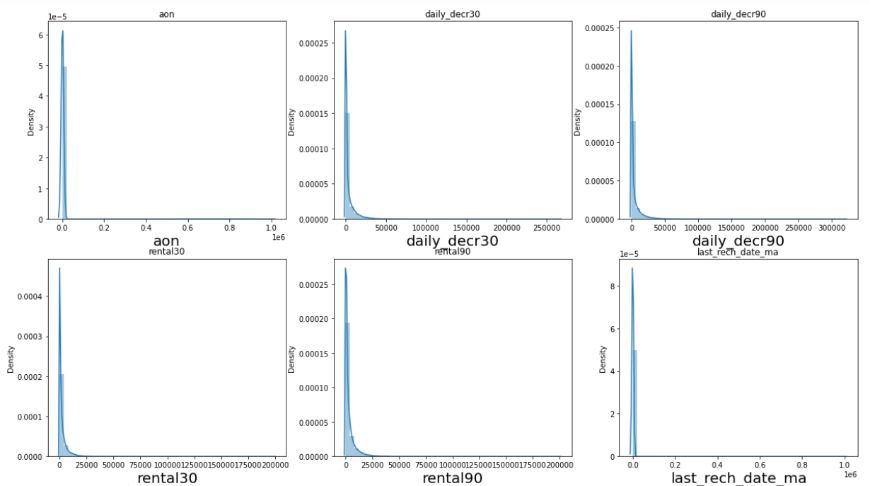
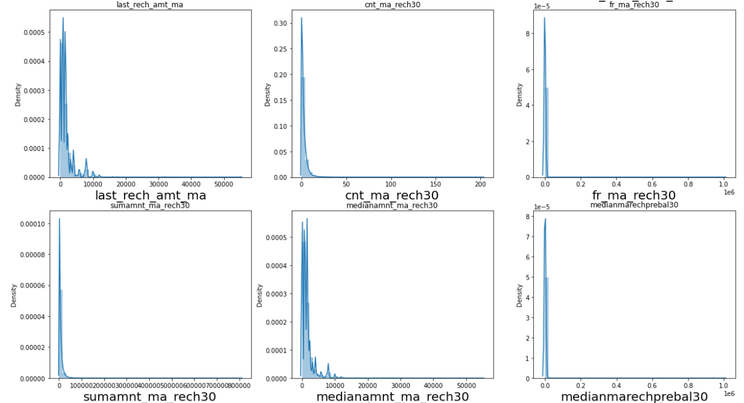
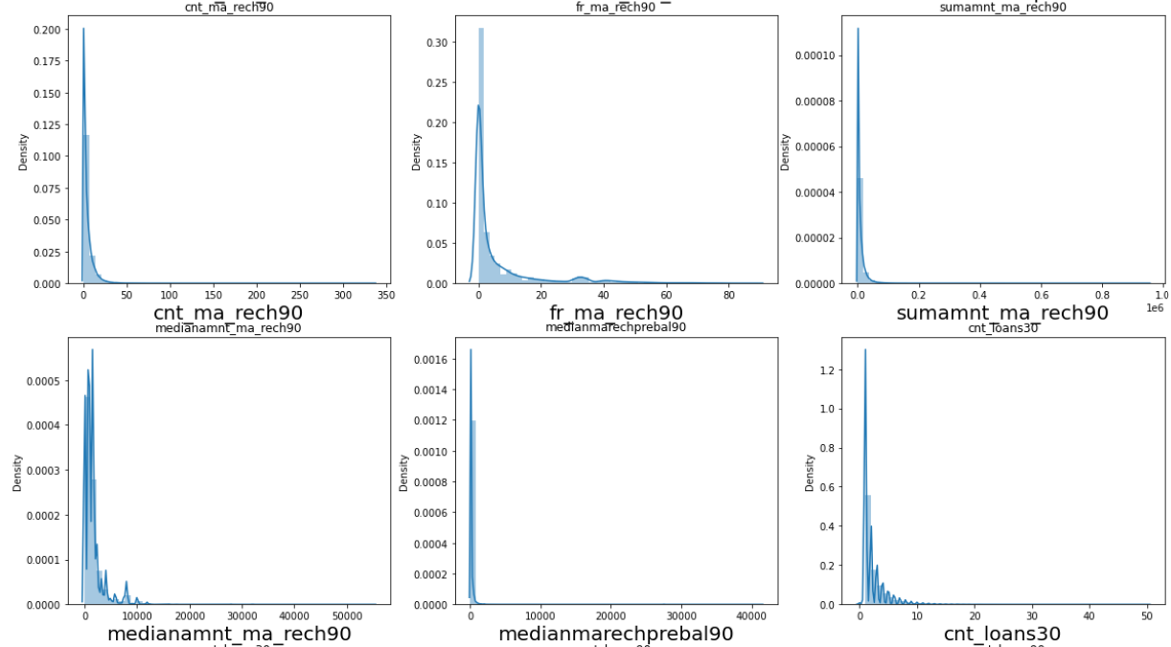
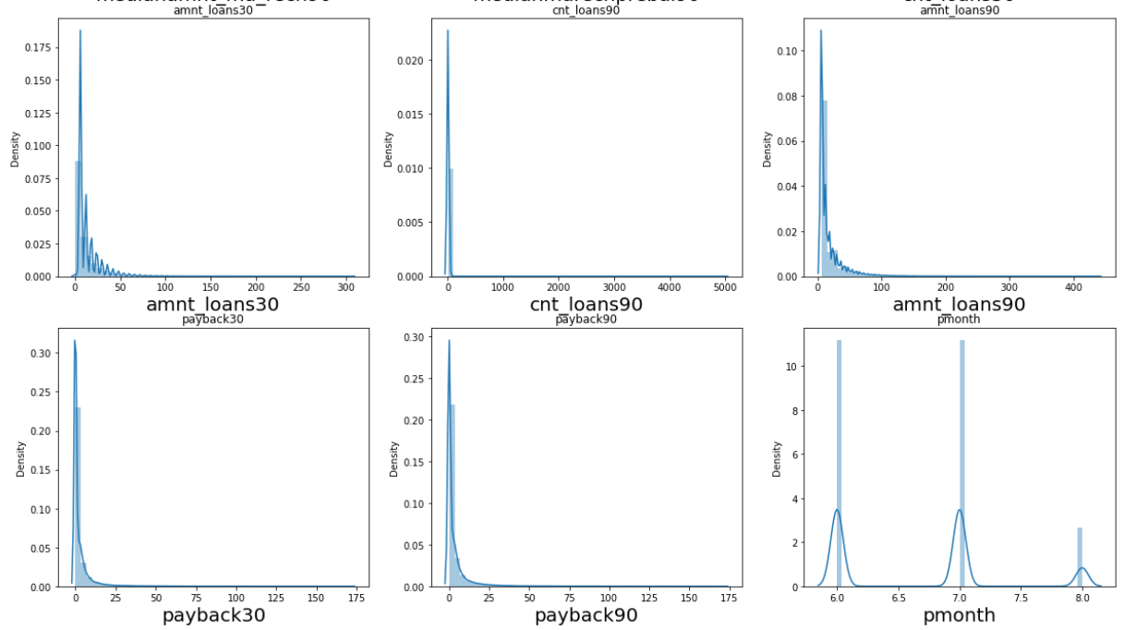
Visualizations

Slide 9
Distribution plot of all columns
Observations:
there is skewness in most of the columns so we have to treat them.
apart from pmonth rest all columns have datapoints in normal distribution (with some distortion also)
pmonth has bimodal plot distribution

Slide 10
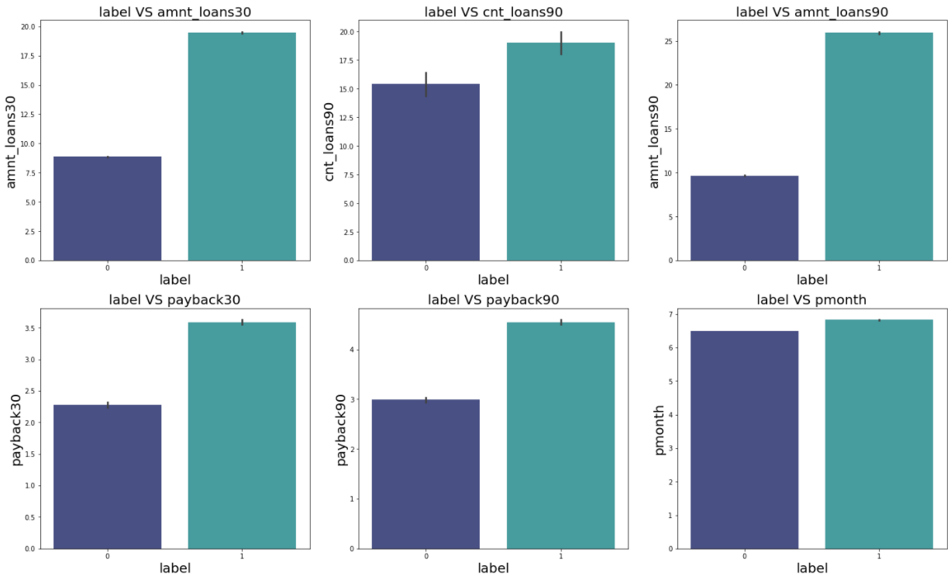
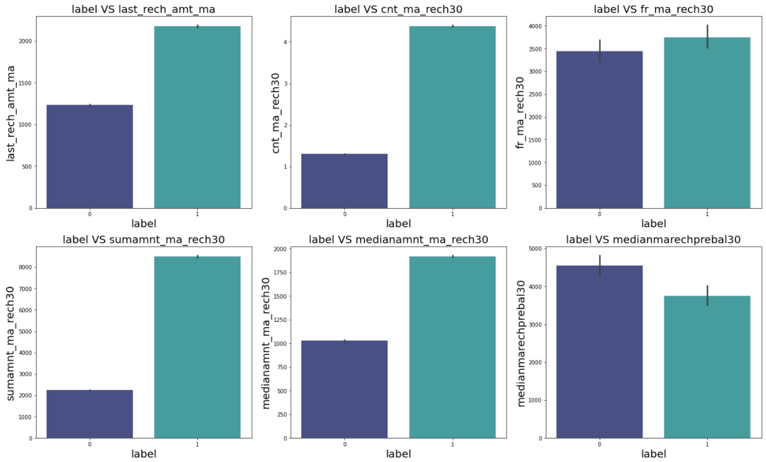
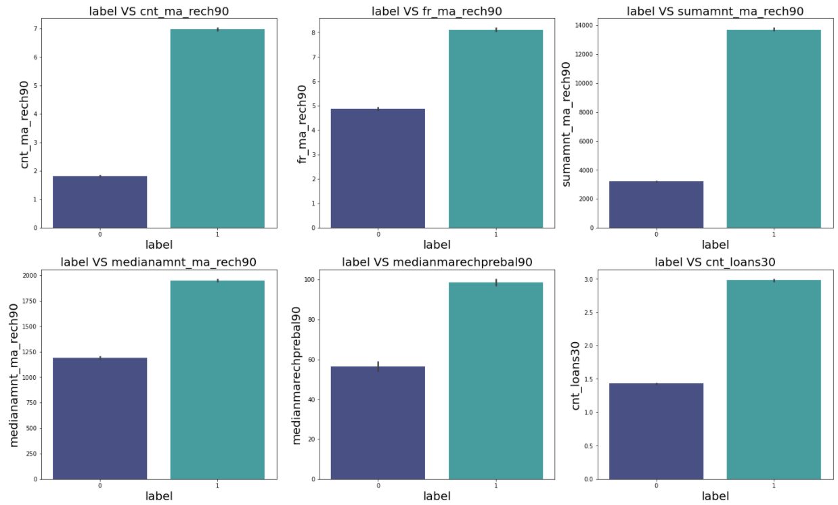
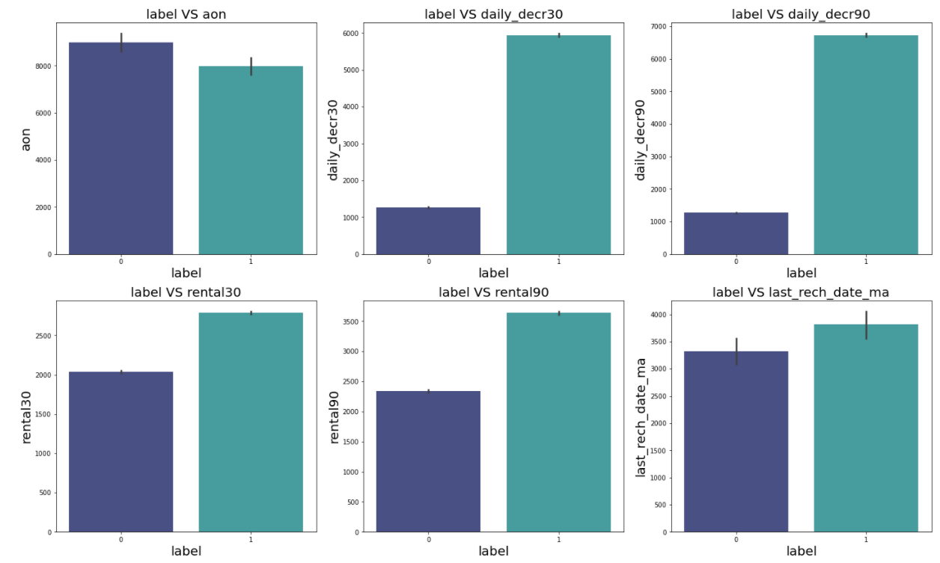
Bar Graph of every column
Observation for all above graphs:
People with longer duration of network usage are maximum defaulters
People with higher Median of main account balance just before recharge in last 30 days at user level are maximum defaulters
Peps with high value of Daily amount spent from main account, averaged over last 30 days (daily_decr30) are maximum indivduals who pay their loan.
Peps with high value of Daily amount spent from main account, averaged over last 90 days(daily_decr90) are maximum indivduals who pay their loan.
Peps with high value of Average main account balance over last 30 days(rental30) are maximum indivduals who pay their loan.
Peps with high value of Average main account balance over last 90 days(rental90) are maximum indivduals who pay their loan.
Peps with high Number of days till last recharge of main account(last_rech_date_ma) are maximum indivduals who pay their loan.
Peps with high value of Amount of last recharge of main account (last_rech_amt_ma) are maximum indivduals who pay their loan.
Peps with high value of Number of times main account got recharged in last 30 days(cnt_ma_rech30) are maximum indivduals who pay their loan.
Peps with high value of Frequency of main account recharged in last 30 days(fr_ma_rech30) are are maximum indivduals who pay their loan and also the count is high for defaulters comparitively Non-defaulters are more in number.
Peps with high value of Total amount of recharge in main account over last 30 days (sumamnt_ma_rech30) are maximum indivduals who pay their loan.
Peps with high value of Median of amount of recharges done in main account over last 30 days at user level (medianamnt_ma_rech30) are maximum indivduals who pay their loan.
Peps with high value of Median of main account balance just before recharge in last 30 days at user level (medianmarechprebal30) are maximum indivduals who pay their loan.

Slide 11
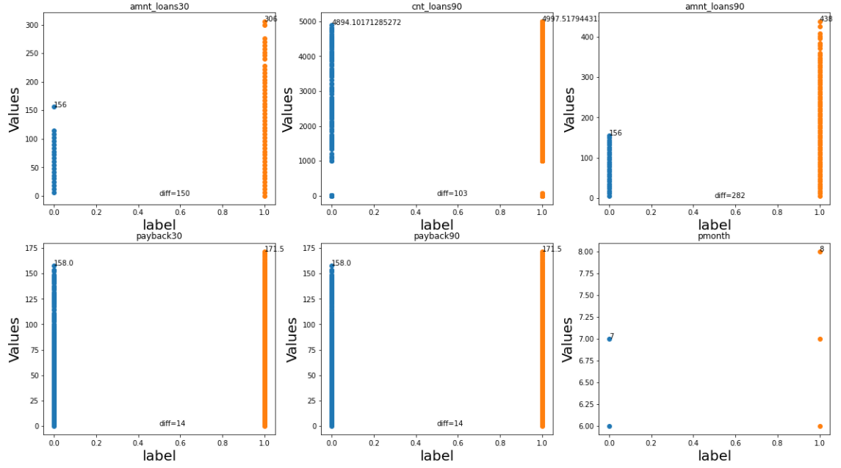
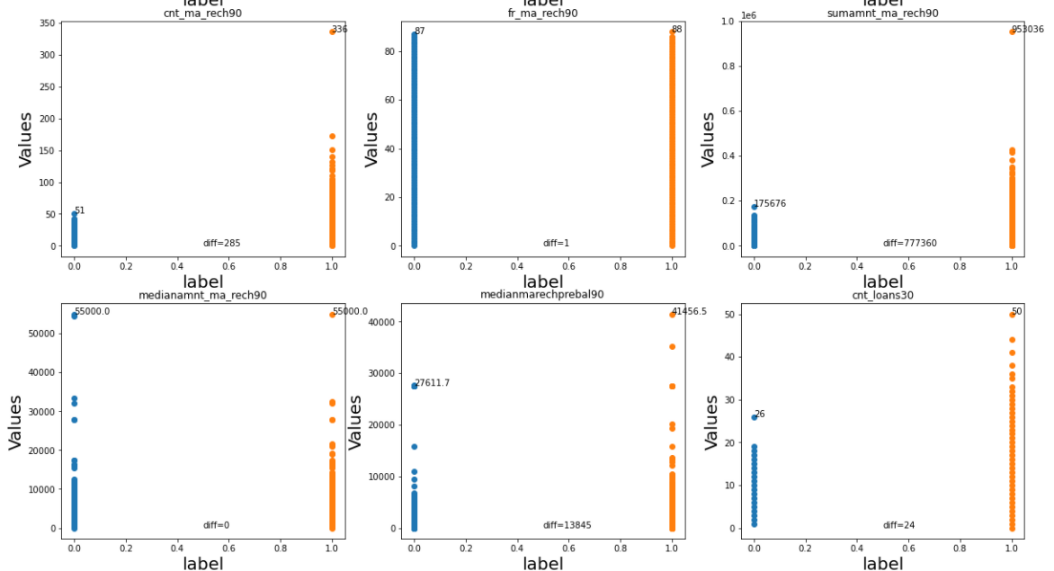
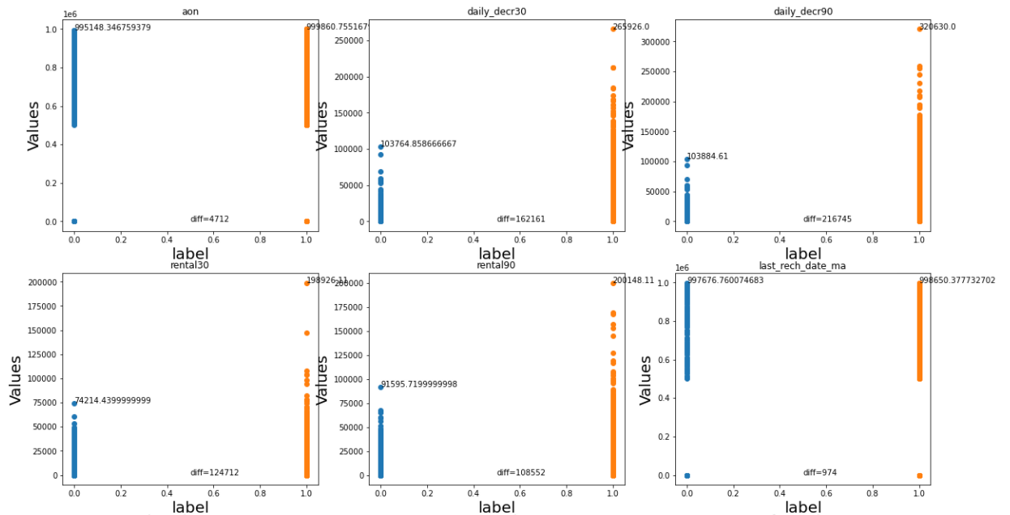
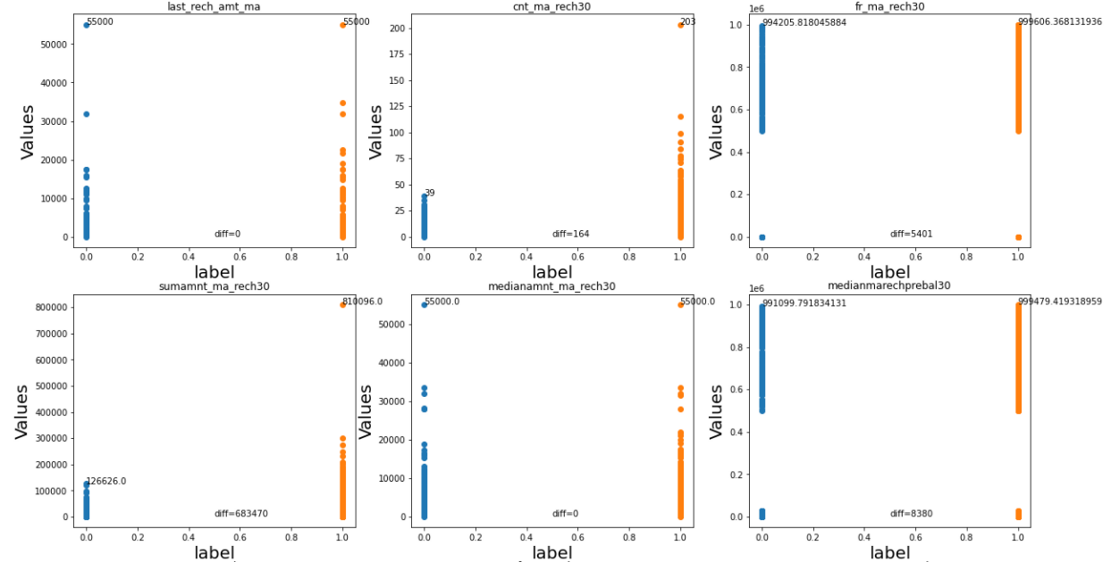
Scatter Plot of each column values w.r.t label column
Peps with high value of Number of times main account got recharged in last 90 days(cnt_ma_rech90) are maximum indivduals who pay their loan.
Peps with high value of Frequency of main account recharged in last 90 days(fr_ma_rech90) are maximum indivduals who pay their loan.
Peps with high value of Total amount of recharge in main account over last 90 days (sumamnt_ma_rech90) are maximum indivduals who pay their loan.
Peps with high value of Median of amount of recharges done in main account over last 90 days at user level (medianamnt_ma_rech90) are maximum indivduals who pay their loan.
Peps with high value of Median of main account balance just before recharge in last 90 days at user level (medianmarechprebal90) are maximum indivduals who pay their loan.
Peps with high value of Number of loans taken by user in last 30 days(cnt_loans30) are maximum indivduals who pay their loan.
Peps with high value of Total amount of loans taken by user in last 30 days(amnt_loans30) are maximum indivduals who pay their loan.
Peps with high value of maximum amount of loan taken by the user in last 30 days(maxamnt_loans30) are maximum indivduals who pay their loan.
Peps with high value of Number of loans taken by user in last 90 days(cnt_loans90) are maximum indivduals who pay their loan.
Peps with high value of Total amount of loans taken by user in last 90 days(amnt_loans90) are maximum indivduals who pay their loan.
Peps with high value of maximum amount of loan taken by the user in last 90 days(maxamnt_loans90) are maximum indivduals who pay their loan.
Peps with high value of Average payback time in days over last 30 days(payback30) are maximum indivduals who pay their loan.
Peps with high value of Average payback time in days over last 90 days(payback90) are maximum indivduals who pay their loan.
Peps having pmonth 8 have always payed back their loan
From bar graph we can also see there are outliers present
search them and remove them

Slide 12
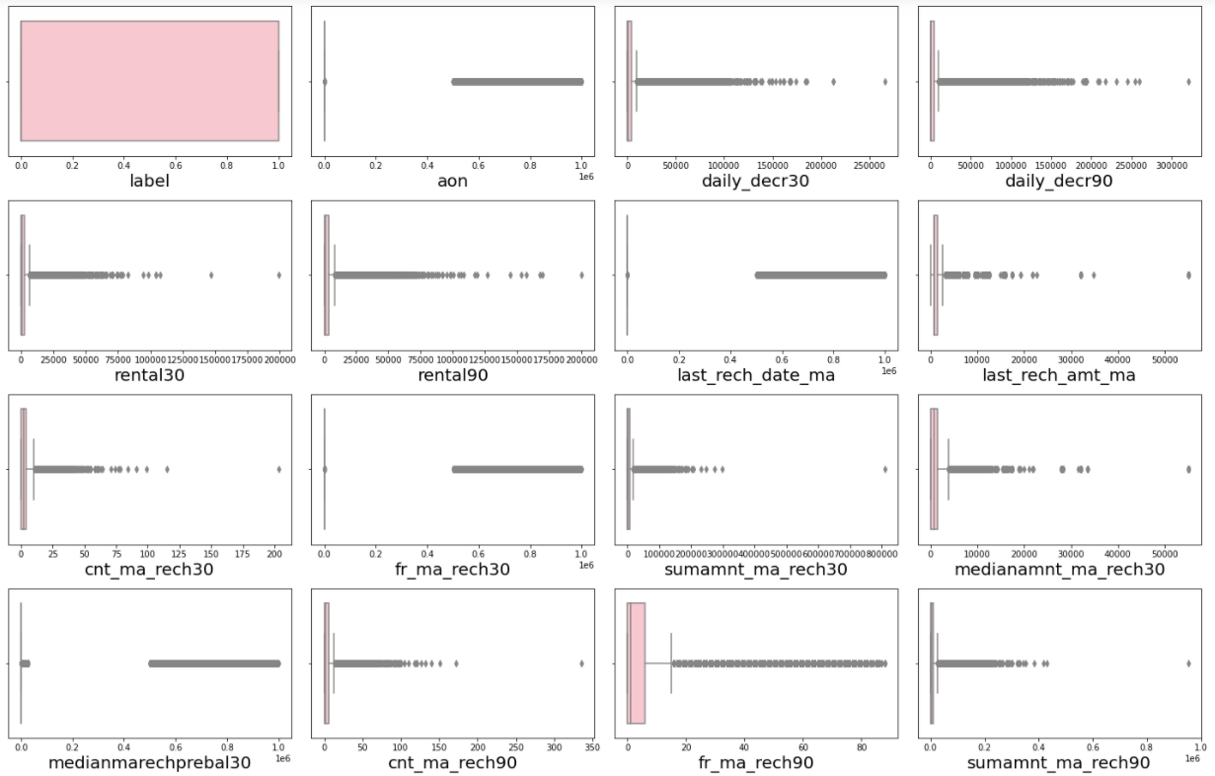
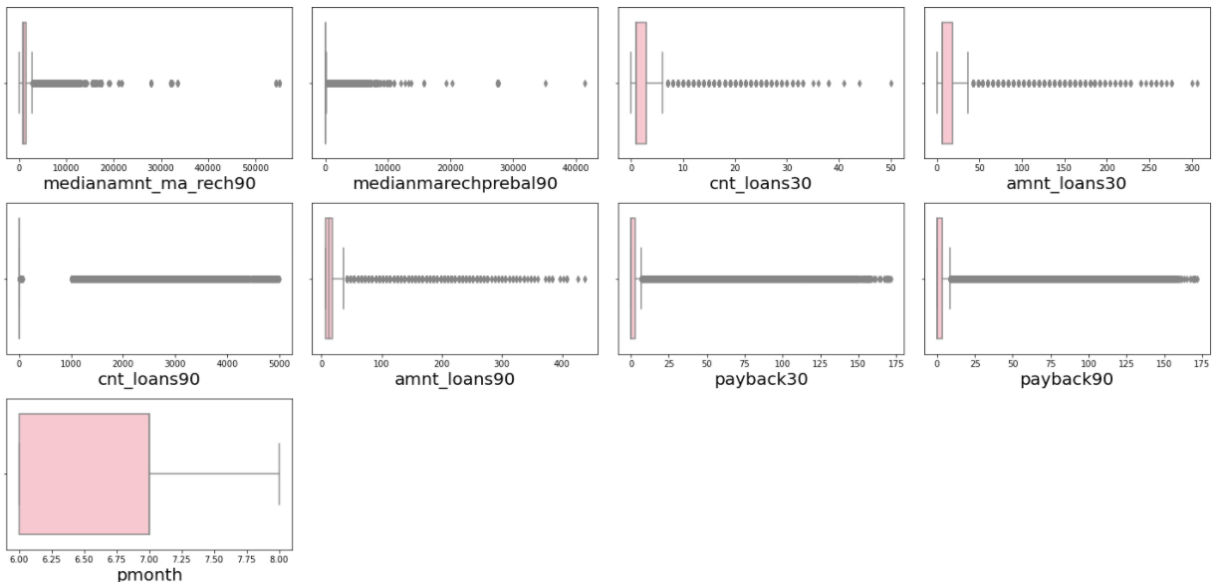
Check For Outliers
Outliers were detected in almost every column, remove them using percentile method

Slide 13
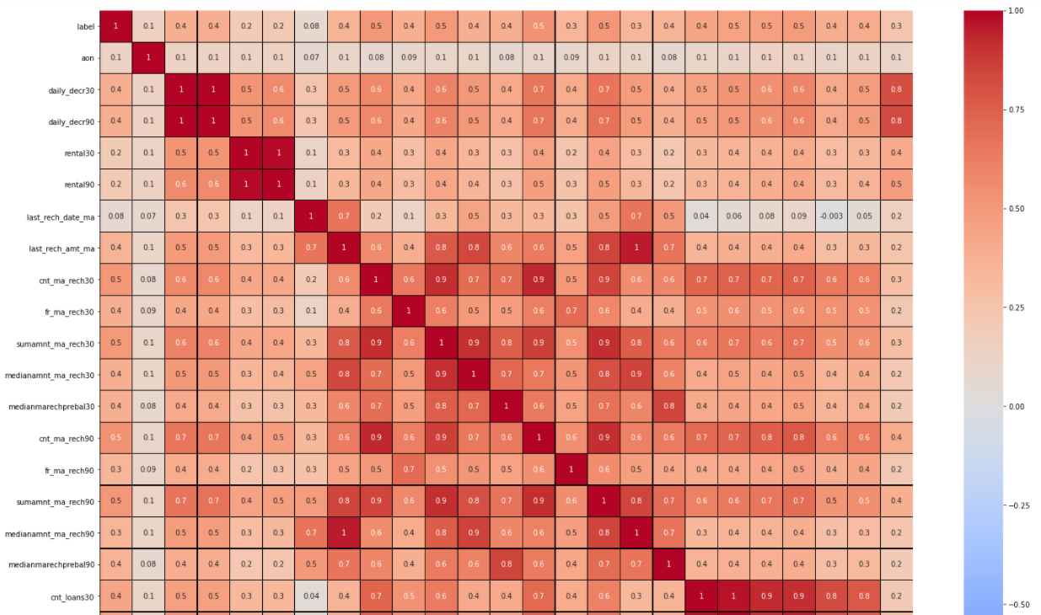
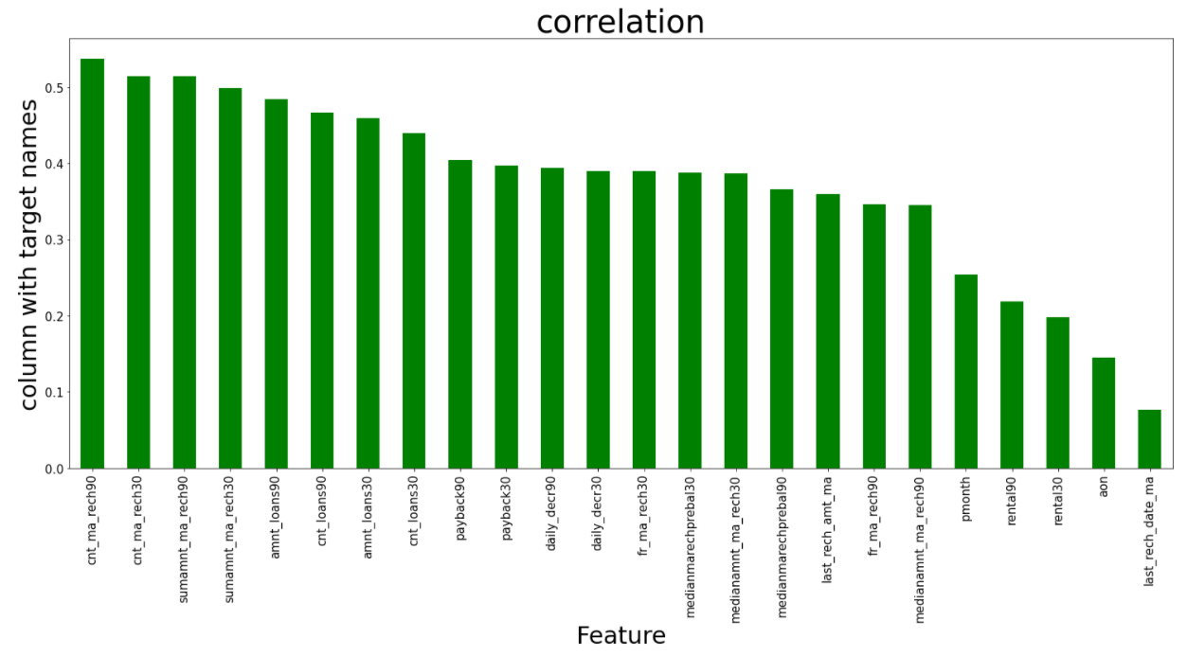
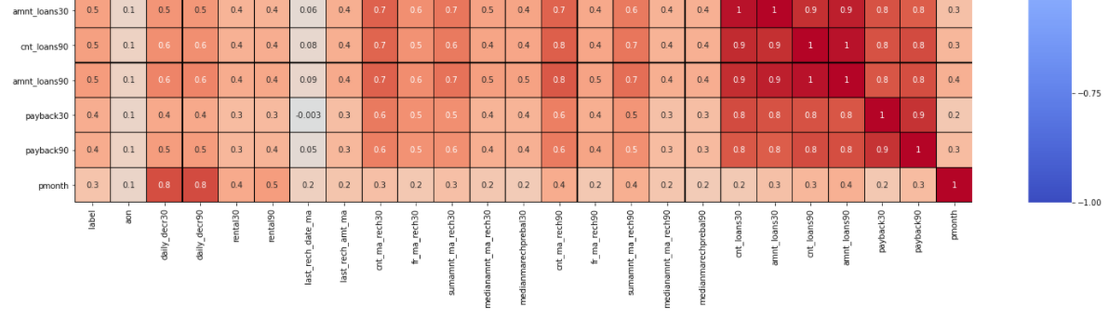
Check For Correlation
Very few columns have high correlation with column label.
drop column last_rech_date_ma as it has extremely low correlation with the target variable label

Slide 14
MODEL TESTING WITH ACCURACY SCORE
Top 3 Models are:
ExtraTreesClassifier: 99%-98% accuracy
RandomForestClassifier: 99% - 97% accuracy
BaggingClassifier: 99%-96% accuracy
We shall hyper tune the best model ExtraTressClassifier and train it, to predict whether the customer will pay the loan or not.
After hyper tuning
ExtraTreesClassifier: 99%-98% accuracy

Slide 15
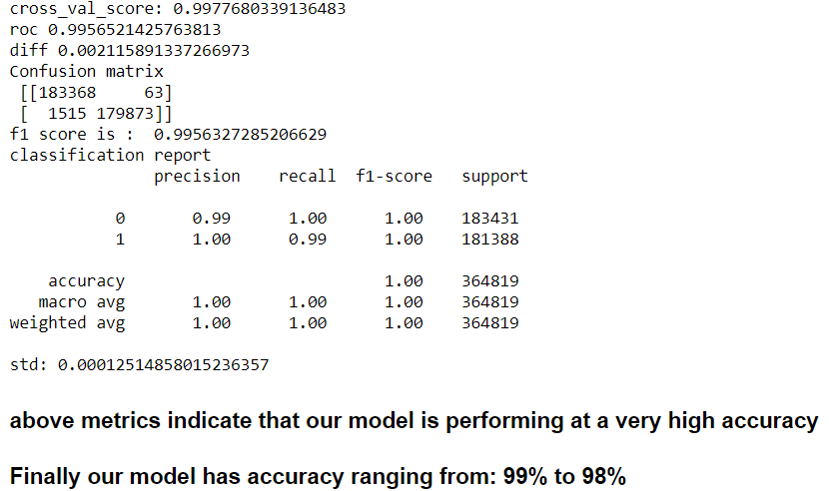
Performance metrics

Slide 16
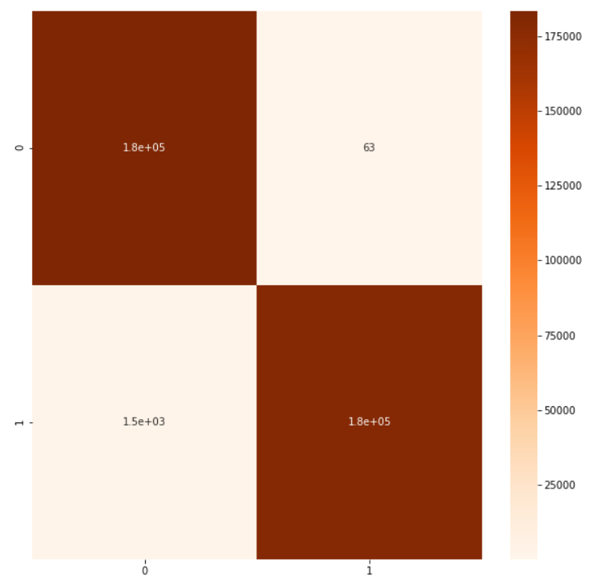
Confusion Matrix

Slide 17
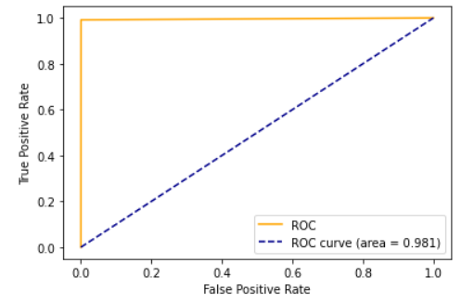
AUC ROC Curve

Slide 18
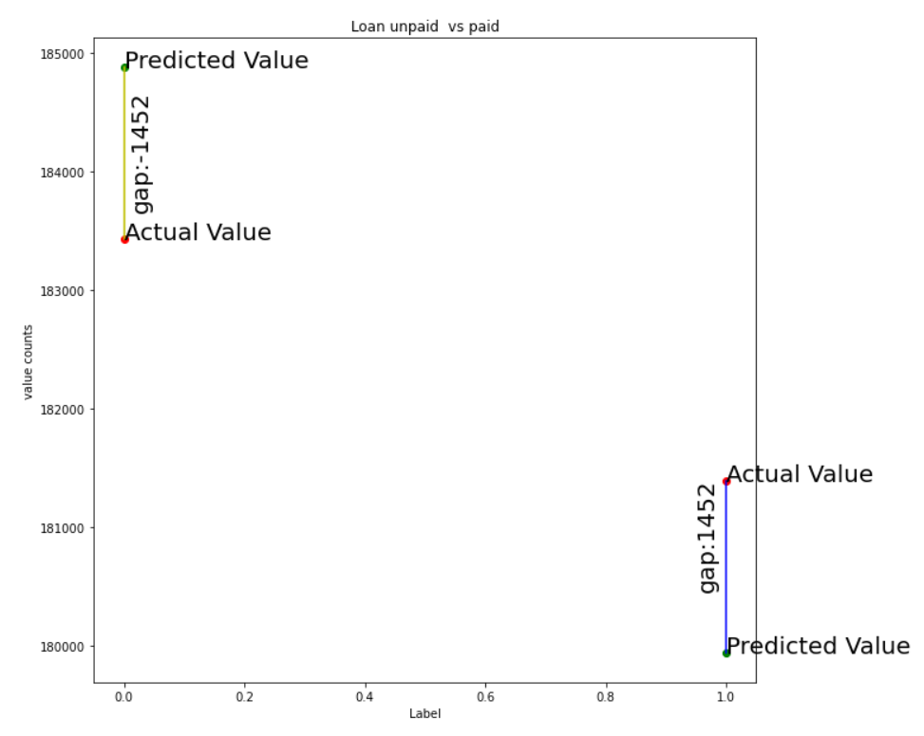
Plot a graph which shows difference between value counts of actual value vs predicted values

Slide 19
Results and Conclusion
We have successfully built a model using multiple models and found that the ExtraTrees Classifier model.
Below are the details of the model’s metrics predicting the dataset
1. Average precision of 1.0
2. Average recall of 1.0
3. F1 Score is 1.0
4. The ability of a classifier to distinguish between classes (AUC) is also 0.99.

Slide 20
Limitations and Scope for Future Work
Due to the presence of lot of outlier, we are unsure whether the model is going to perform well to a completely new dataset.
Due to a class imbalance, we had to rebalance the class 0. This might also have some effect while trying to predict the outcome with completely new data
During data-collection, we could place limits on few continuous variables, where the customer could enter data within a limit because the variables like age on the network cannot be more than certain months

